Slide 1
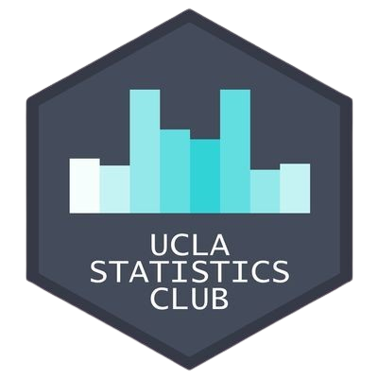
Intro to ML Workshop
Benjamin Yu & Reeshad Mohammed

Slide 2

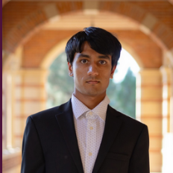
About the Presenters
Reeshad
Mohammed
Benjamin Yu
Workshop Co-Chair
Data Theory Major
Workshop Co-Chair
Statistics & Applied Math Majors, Digital Humanities Minor

Slide 3
Table of Contents
01
Introduction: What is machine learning?
Basic introduction to machine learning
02
Supervised Learning
Learning with data and target pairs
03
Unsupervised Learning
Learning patterns in data without labels
04
Reinforcement Learning
Exploring the environment to learn data
05
Generative AI, a glimpse
How ML models generate new data

Slide 4
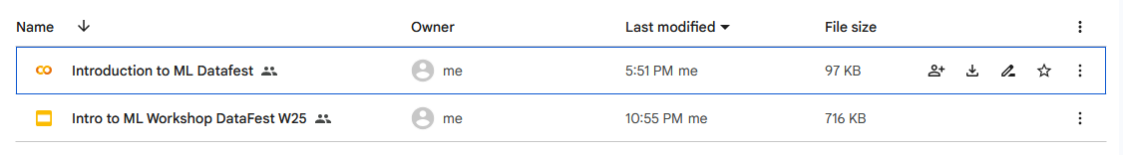
Instructions
Open Google Drive Link: https://tinyurl.com/IntroToMLDF
Click on “Intro to ML Datafest.ipynb”
To access our Workshops on GitHub:
https://tinyurl.com/UCLAStatsWorkshops

Slide 5
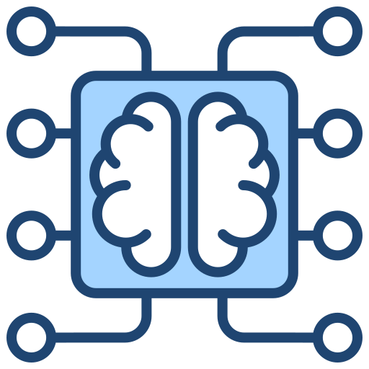
Introduction
Machine learning is the study of algorithms that can learn from data and generalize to unseen data.
Machine learning can be separated into three groups: supervised, unsupervised and reinforcement learning
What will be covered in this presentation is surface level and will require further investigation

Slide 6


Slide 7
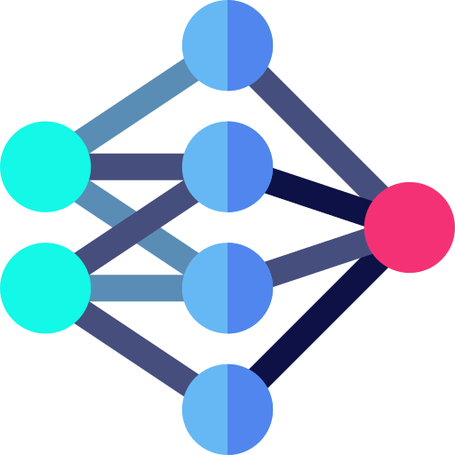
Classical vs Deep Learning
Classical learning uses mathematical/statistical methods to learn patterns (linear regression, clustering, etc.)
Deep learning uses neural networks primarily as its method to learn patterns from data.

Slide 8
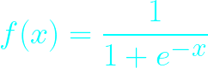
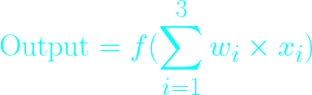
Neuron
x₁
w₁
Activation function
w₂
Output
x₂
Sum
w₃
x₃

Slide 9
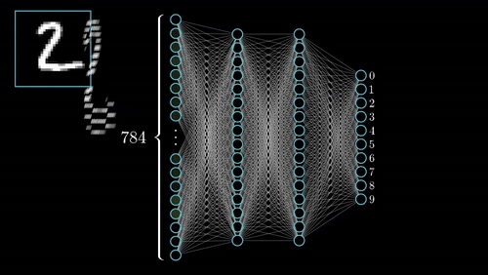
Deep Learning: Classification

Slide 10
How exactly do these models learn?

Slide 11
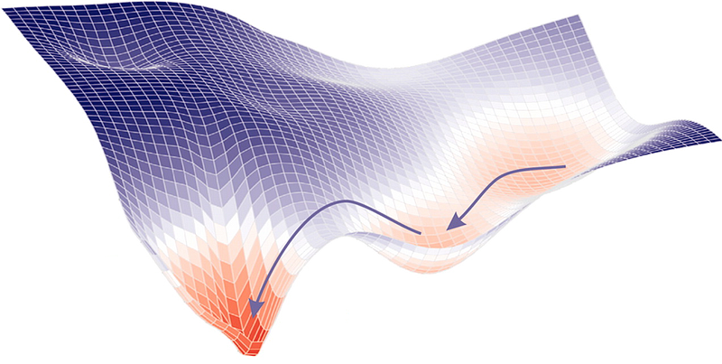
Model learning
Models learn by minimizing loss functions (domain specific)
Gradient Descent (and its many variants) modify the weights by iteratively taking the negative gradient of the loss function at a given point and move in that direction

Slide 12
What are the various types of machine learning?

Slide 13

Supervised Learning
Supervised learning is a subset of machine learning which utilizes labeled data to train a model to learn certain qualities/features.
Applications: honestly almost everything ML is probably supervised

Slide 14
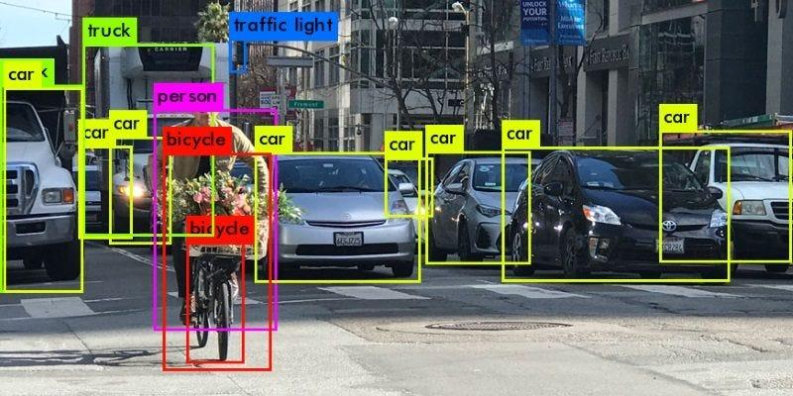
Example: Image Recognition
The application of image recognition uses pictures + label pairs to train deep neural networks to identify objects in images. Common networks used for image recognition tasks include R-CNNs (and its variants) and Vision Transformers.

Slide 15
Simple example: Regression
Given information about the housing market, predict the housing prices of California houses
Using a deep neural network, we aim to predict the housing price given this data

Slide 16
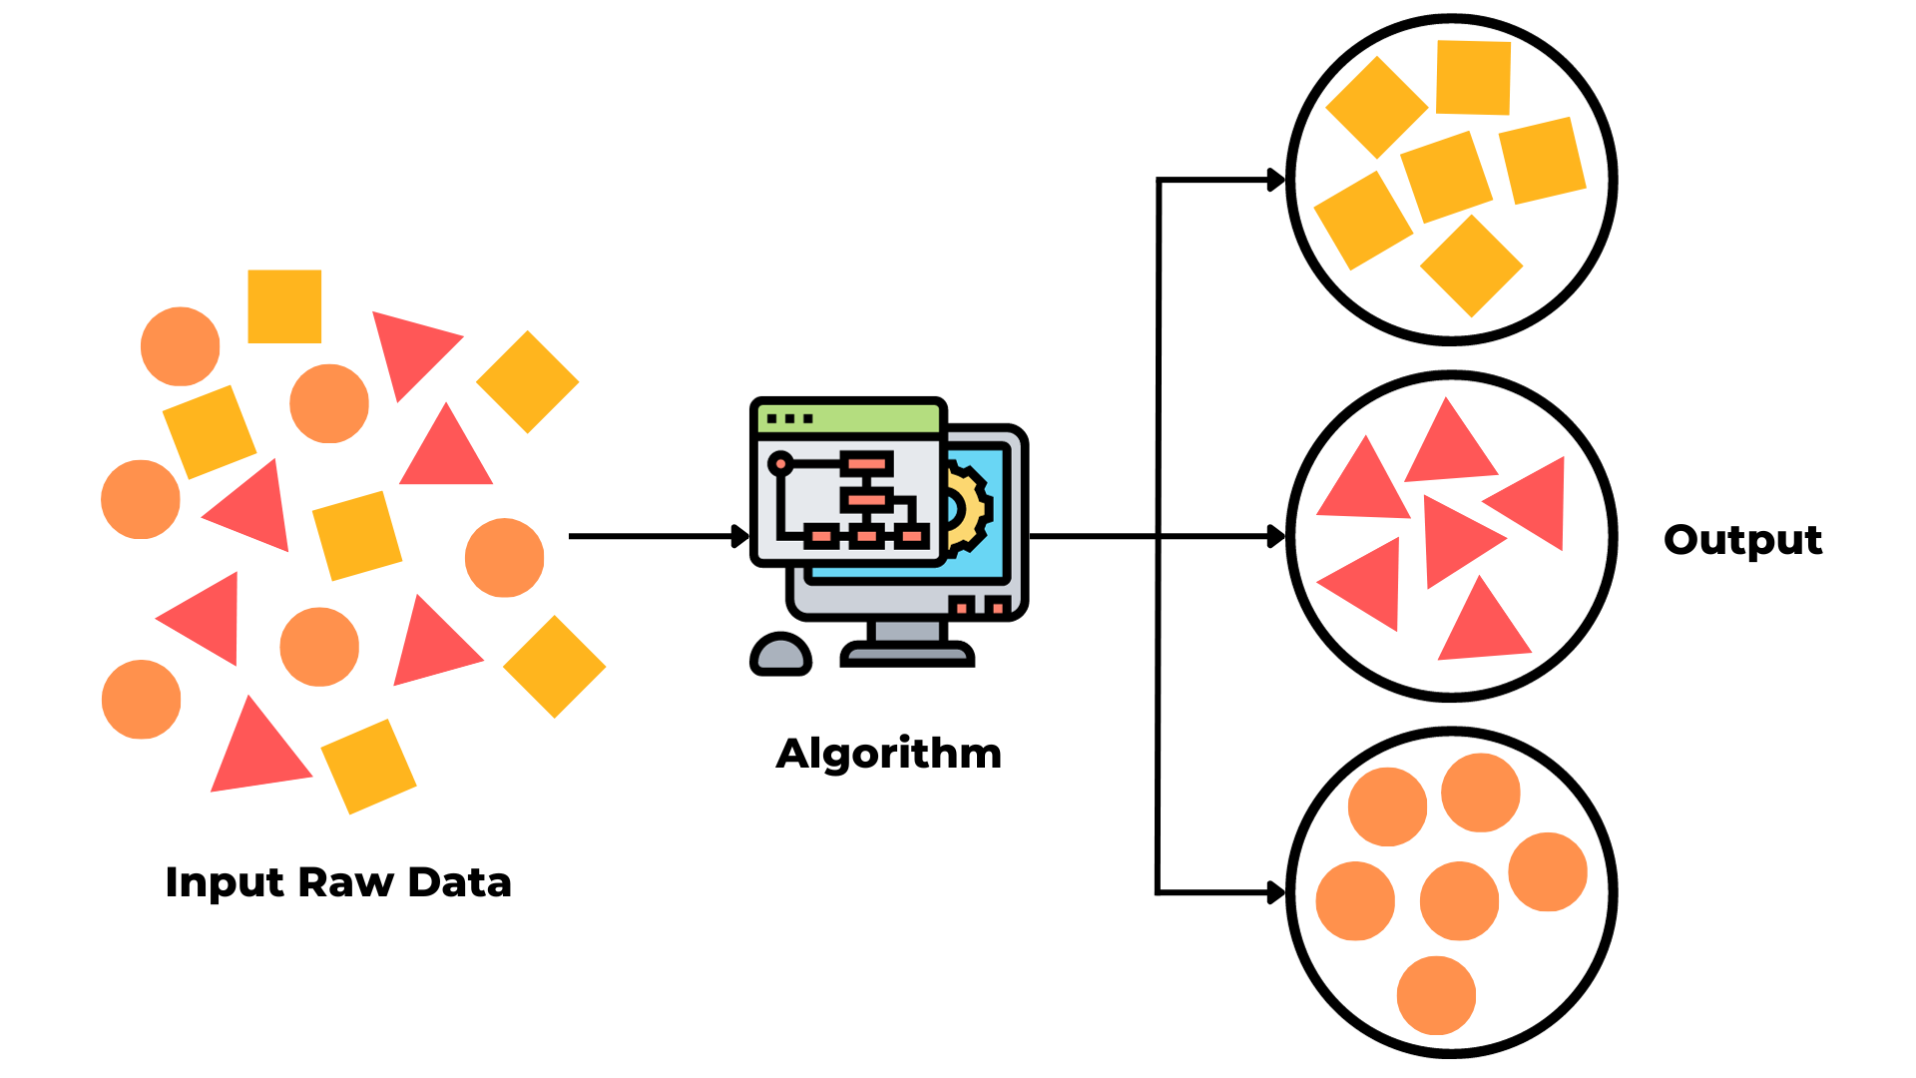
Unsupervised Learning
Unsupervised learning is the subset of machine learning responsible for learning patterns from data without human supervision
Applications: anomaly detection, recommendation systems, clustering, and more

Slide 17

Example: Netflix Recommendations
Netflix uses unsupervised learning to analyze viewer habits (what they watch, for example) and cluster them together and suggest content for them to watch.
Due to the large nature of Netflix viewers as a dataset, in practice it is very complex, but we can see a small scale example to gain some intuition.

Slide 18
Simple Example of Recommendations
Suppose there are 3 people: Alice, Bob, and Carter
Suppose there are 4 tv shows denoted by colors
Carter watched “turquoise”, which Alice also watched. So Carter’s recommendation would align with Alice’s watch habits. Alice additionally watched “gray”, so Carter will be recommended “gray”.
Alice
Bob
Carter

Slide 19
Algorithms for Unsupervised Learning
There are many algorithms for unsupervised learning
Here are two popular and easier to understand ones:
K-Means Clustering
Principal Component Analysis (PCA)
For this Intro Workshop we will specifically look at K-Means Clustering

Slide 20
K-Means Clustering Example
Clustering example data into some clusters
Notice how clusters work
Notice how adding points influences the clusters

Slide 21
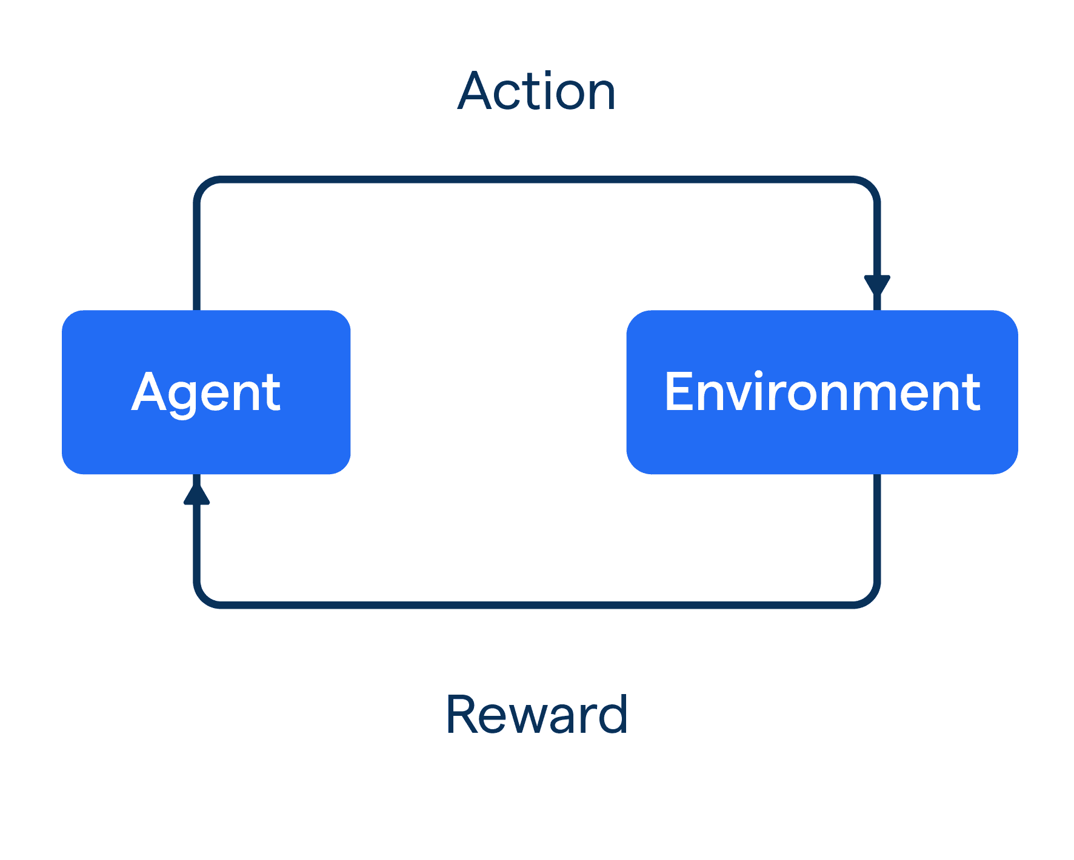
Reinforcement Learning
Reinforcement learning (RL) learns by interacting with its environment and learning which actions maximize results.
The idea of rewards/punishments is present in RL, for games, this is in terms of “win”, “loss”, and sometimes “draw” factors
Applications: games, training LLMs

Slide 22

Example: AlphaZero
AlphaZero uses RL to play board games at a high level It is known to be powerful in games such as Shogi, Go, and Chess.
These games have these properties:
2 player
Any legal position (with best play) is predetermined as a win, loss, (or draw for chess/shogi)
With best play, there is no luck or chance

Slide 23
AlphaZero and Chess
In theory, chess can be solved, but the amount of games possible with different moves is infeasible to achieve practice
AlphaZero is unique in that it doesn’t use preexisting chess theory to learn to play, but rather plays itself (a lot) to learn
Its goal is then to maximize reward (“winning”) based on game positions
It uses Monte Carlo Tree Search (MCTS) and Deep Convolutional Neural Networks (DCNN)

Slide 24
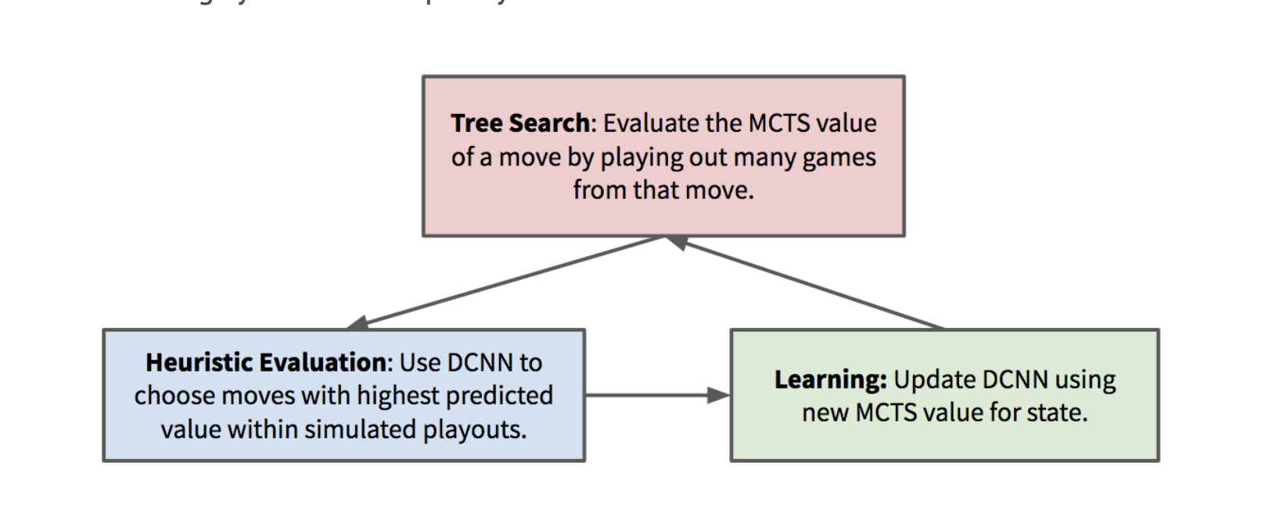
AlphaZero and Chess

Slide 25
So how does generative AI play into this?

Slide 26
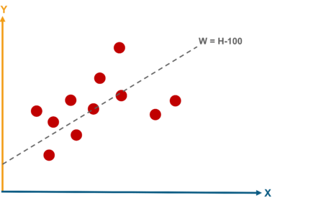
A motivating example
“Traditional” deep learning: classification, regression, etc. is like interpolation: given an input, you want to find an (often deterministic) output
Generative AI learns the probability distribution of the data and generates new samples by drawing from it.

Slide 27
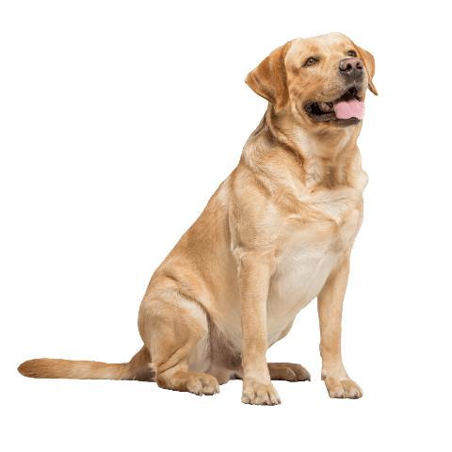

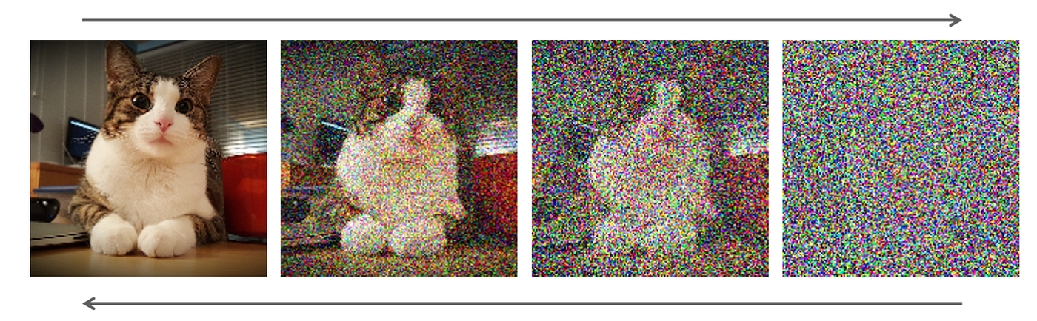
Intuitive explanation of Diffusion
Diffusion, given a dataset, iteratively adds noise to images until it become complete noise. During inference, given random noise, it aims to generate a coherent image.
What diffusion is doing (intuitively) is mapping images from the dataset to a probability distribution, which it will then “sample”.

Slide 28
Future Directions
Should familiarize yourself with basics of Deep Learning first: training & testing, model evaluation, etc.
After that: everyone read the paper for transformers (Attention is all you need)
Computer vision: CNN (and its variants), ViT, diffusion
Natural language processing: understand how LLMs train/infer
Basically anything mentioned you can probably spend a good amount of time looking into any of these topics

Slide 29
For DataFest, what should I know?
Aim: interpretability
Clustering: look at better clustering algorithms, especially ones which require no domain knowledge (HDBScan is a good place to start)
Decision trees: interpretable way to determine patterns in data
Find new information in data:
Sentiment analysis (simple example shown during underclassmen Datathon)
LLM API’s are a good thing to look into/

Slide 30
Questions?

